Slide 1
STUDENT PORTAL
HC NEXUS: Academic Management Platform
Divanshi Khosla | Zlaark, Amritsar

Slide 2
02 Problem
• Students navigate multiple systems to access dispersed academic information
• Critical data lacks centralized visibility and real-time access
• Manual processes create inefficiencies in tracking academic progress
• Fragmented information limits data-driven student decisions

Slide 3
03 Solution
• Unified HC Nexus portal consolidating all academic information in one interface
• Secure authentication via roll number and password verification
• Multi-module architecture with personalized dashboards and analytics
• Real-time access to attendance, grades, schedules, and announcements
• Responsive Streamlit design accessible across all devices

Slide 4
04 Tech Stack
• Python – Core language for rapid application development
• Streamlit – Interactive web framework for multi-page interfaces
• Pandas – Data manipulation and CSV processing
• CSV & JSON – Structured data storage for records
• ReportLab – Professional PDF generation for receipts
• Git & GitHub – Version control and collaboration

Slide 5
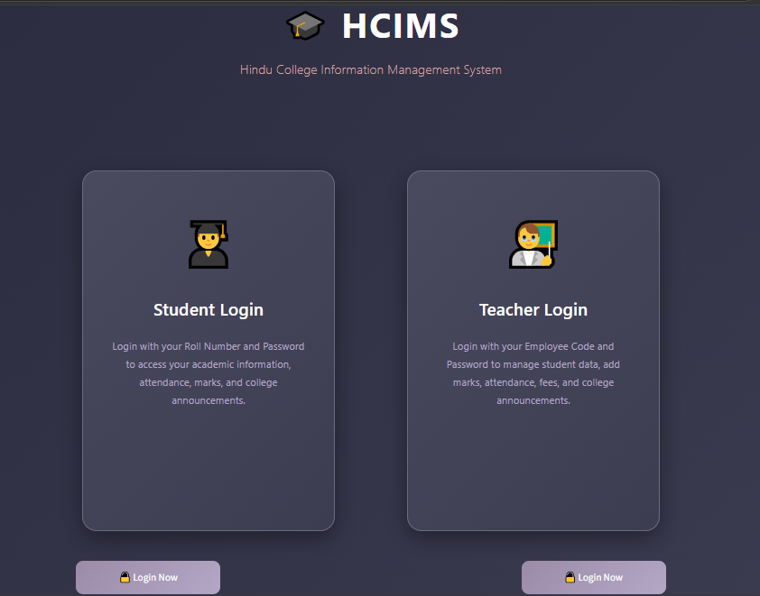
05 Architecture
① Authentication
Roll number & password
② Data Processing
Pandas CSV parsing
③ Business Logic
Attendance, marks, fees
④ Presentation
Streamlit interface
⑤ Integration
Teacher-student sync
✨ App Screenshot
(Login/Dashboard)

Slide 6
06 LIVE DEMO
• Authentication system with secure login credentials
• Dashboard displaying student profile and academic summary
• Attendance module showing percentage and classes attended
• Marks tracker with subject-wise performance and CGPA calculation
• Timetable visualization with schedule and venue information
• Notices feed with teacher-published announcements and attachments

Slide 7
07 AI Component
Claude & ChatGPT leveraged for specific development tasks and documentation purposes.
Current focus: Student data management, navigation, authentication, and responsive interface design.
AI integration areas: Report generation, documentation automation, and workflow optimization.
Future scope: Advanced analytics, predictive modeling, and intelligent student assistance systems.

Slide 8
08 Challenges
• Session state management in Streamlit's stateless architecture
• Complex CSS styling with limited native component customization
• Professional PDF generation and formatting
• Data consistency across multiple modules and calculations
• Responsive design across varying screen sizes

Slide 9
09 My Role
• Architected complete student portal from conception to deployment
• Developed secure authentication with session management
• Implemented multi-module dashboard with real-time data processing
• Designed and optimized UI for accessibility and usability
• Deployed production-ready application on Streamlit Cloud

Slide 10
10 Future Improvements
• Migration to relational database for enhanced scalability
• Role-based access control for students, faculty, and administration
• Online payment gateway integration for digital fee transactions
• Push notifications for real-time updates on notices and grades
• Mobile-responsive progressive web application design

Slide 11
11 GitHub Link
• Repository: github.com/divanshiplum/SPY-X-CODE
• Complete commit history documenting development progression
• Modular Python scripts with comprehensive documentation
• Integrated workflow demonstrating professional practices
• View architecture decisions and deployment configuration

Slide 12
THANK YOU
Questions & Discussion

